Slide 1
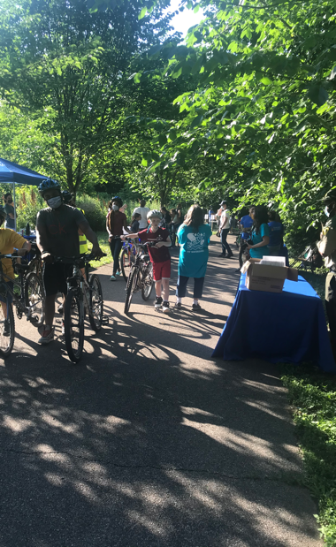
Tacony Creek Park
Public Opinion Survey
December 2021 – June 2022
Findings
June 13, 2022

Slide 2
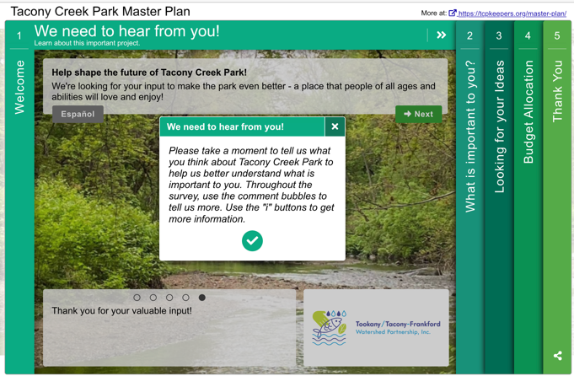
Methodology

Slide 3
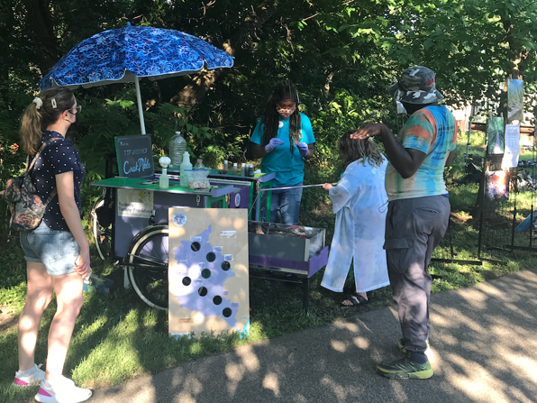
Findings
Typical Profile
English: 226
Spanish: 18
Female
White
45-64

Slide 4
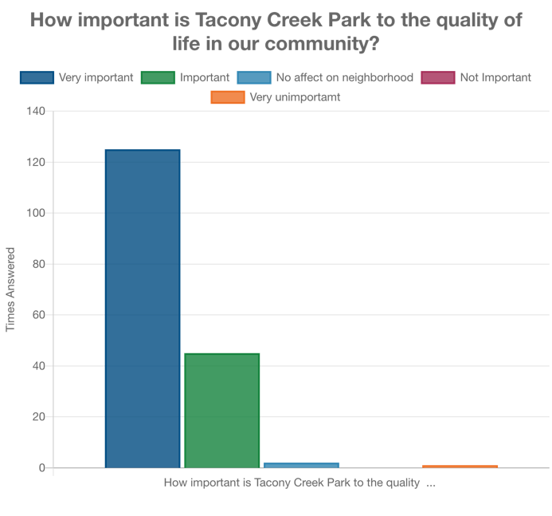
Park Importance
All say the park is Very Important or Important…
…except for 1 not important and 2 no affect in neighborhood

Slide 5
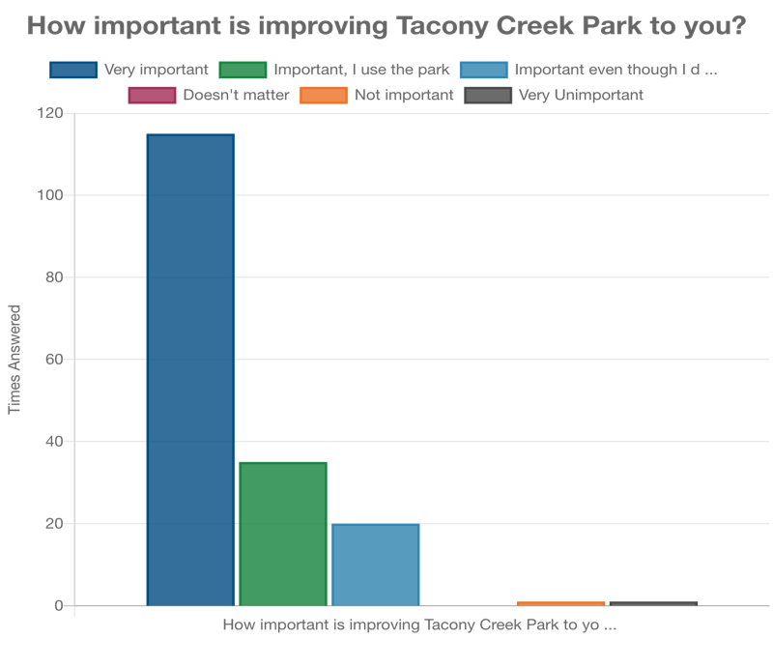
Importance of Improving the Park
Almost all say improving the park is Very Important or Important…
…20 even though they don’t use the park…
…2 not important

Slide 6
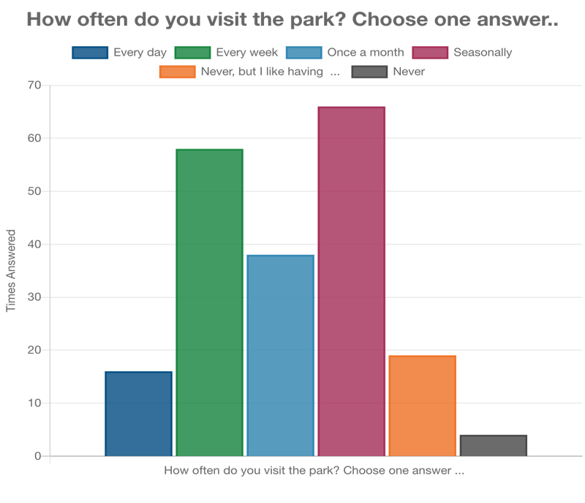
Park Visitation
Seasonally
Weekly
Monthly

Slide 7
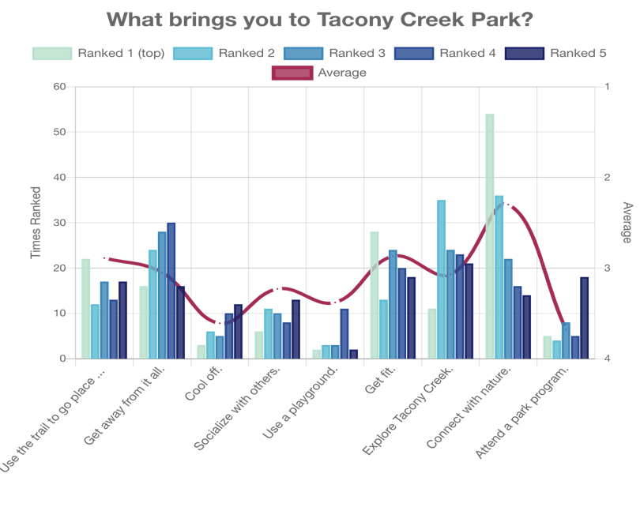
Park Attractions

Slide 8
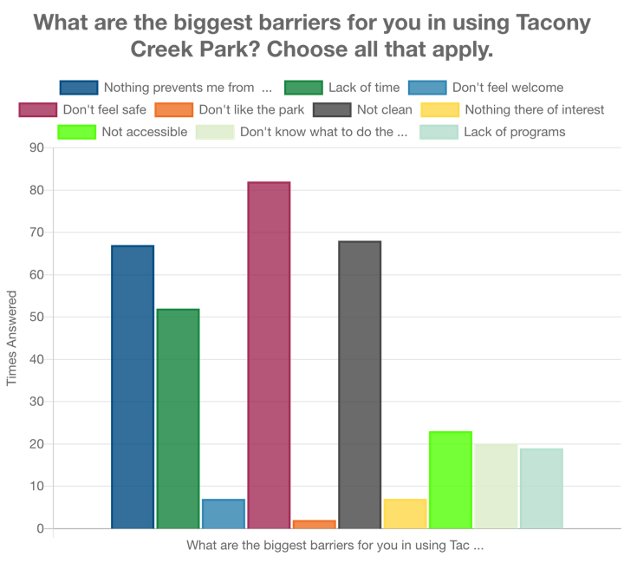
Barriers to Use
Don’t feel Safe
Not Clean
Nothing Prevents
Me from Using Park

Slide 9
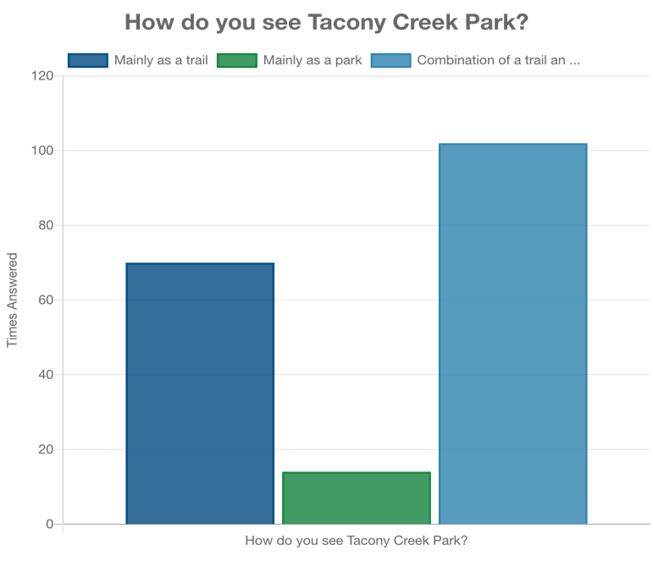
A Park and a Trail!

Slide 10
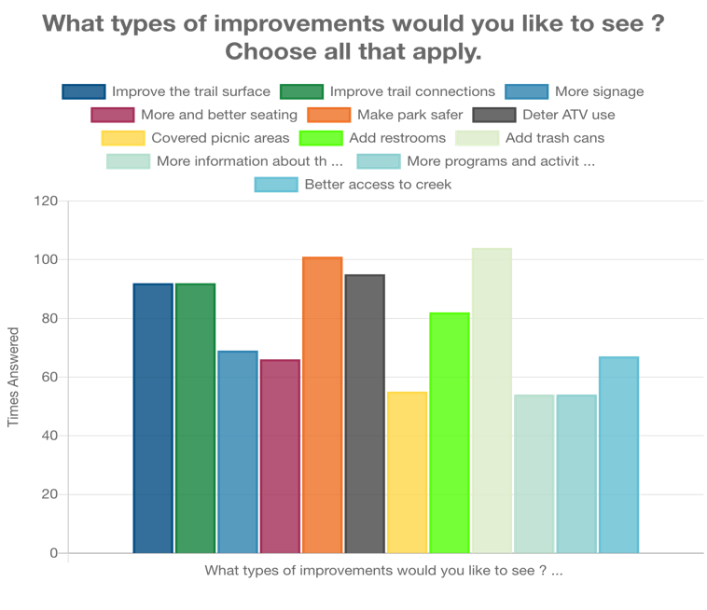
Preferred Improvements
-Trash Cans
- Make Park Safer
- Deter ATV Use
- Improve Trail
Surface
- Improve Trail
Connections

Slide 11
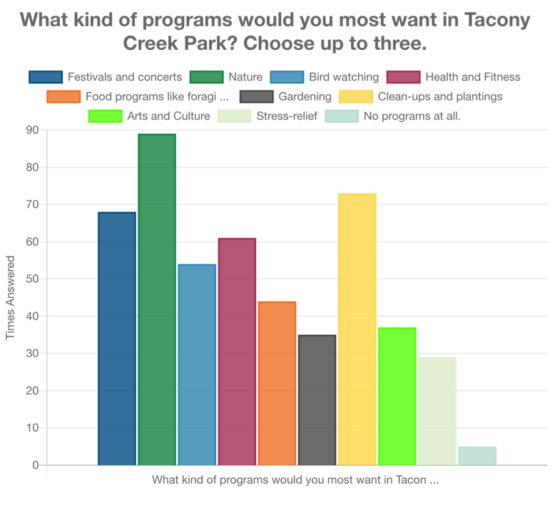
Preferred Programs
-Nature
- Clean Ups &
Plantings
- Festivals &
Concerts
- Health & Fitness
- Bird Watching

Slide 12
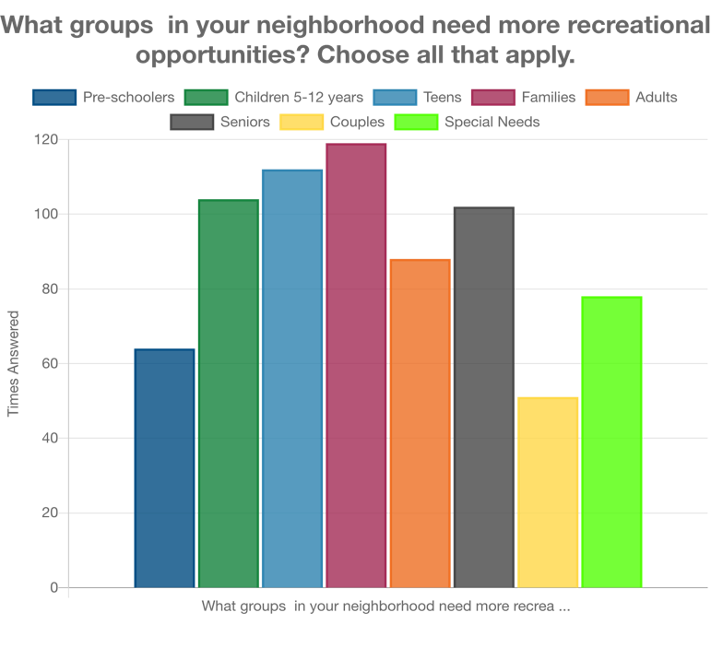
Groups Needing more Opportunities
-Families
- Teens
- Children 5-12
- Seniors
- Adults

Slide 13
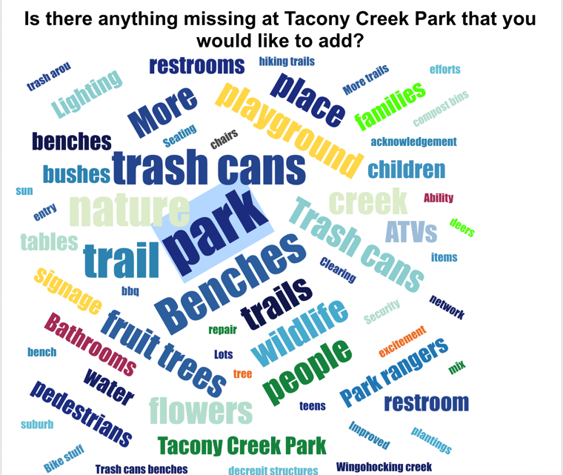
What’s Missing?

Slide 14
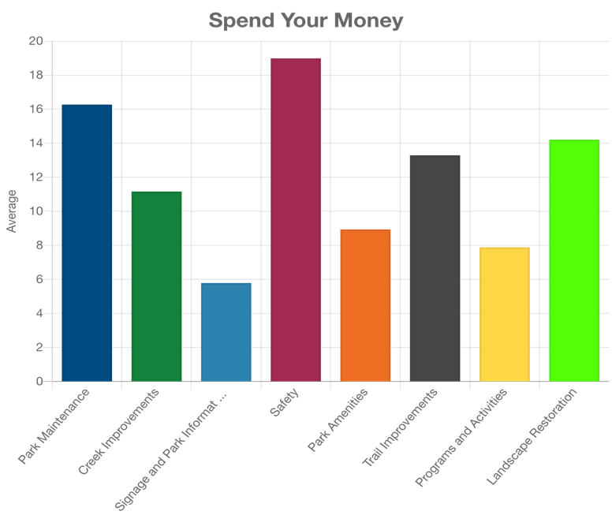
How would you spend $100 on Tacony creek
Park?
- $18.99 Safety
- $16.27 Maintenance
- $14.21 Landscape
Restoration
- $13.29 Trail
Improvements
- $11.16 Creek
Improvements

Slide 15
Comments
136 Open Ended Comments

